Slide 1
MEC101
Mechanical Sciences-I
Chapter 2
Force-Deformation Relations

Slide 2
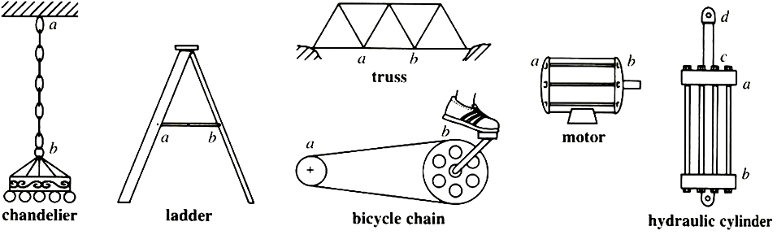
Structures in Tension

Slide 3

Springs
δ
P = kδ
P
k is the spring constant

Slide 4
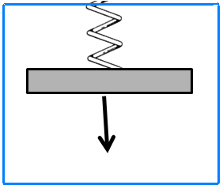
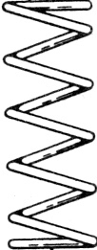
Springs in series
T₁ = P
k₂
T₂
k₁
P
Similarly, T₂ = P
δ
P
δ₁ = P/k_{1,}
δ₂ = P/k₂
Geometric compatibility: δ = δ₁ + δ₂

Slide 5
Springs in series...
Geometric compatibility:
δ = δ₁ + δ₂
k₂
k₁
P/k = P₁/k₁ +P₂/k₂
P
1/k = 1/k₁ + 1/k₂

Slide 6
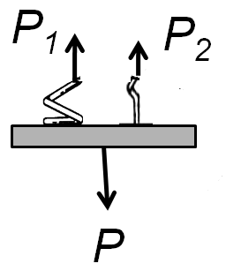
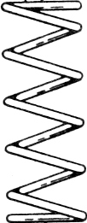
Springs in Parallel
δ
P = P₁ + P₂
P
P₁= δ₁k₁
P₂= δ₂k₂
P = δk
δ = δ₁= δ₂
k = k₁ + k₂

Slide 7


Elastic Bar
P
P/A
δ
δ/L
Stress/Strain = E
a material property
N/m² = Pascal (Pa)
δ
P
P

Slide 8
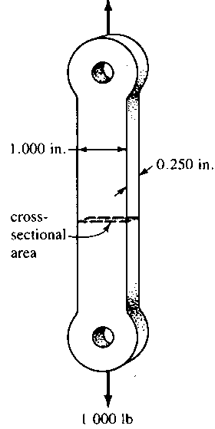
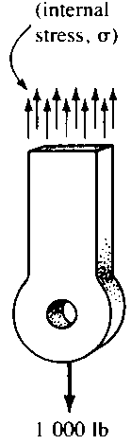
Bar as a spring
P/A
δ/L
P/A = E(δ/L)
Or, P = (EA/L)δ
So, k_{effective} = EA/L

Slide 9
Some Typical Values of E
Material | E
Tungsten Carbide | 400 – 700 GPa
Steel | 200 GPa
Aluminium | 70 GPa
Wood | 7 – 14 GPa
Nylon, Epoxy | 0.27 – 0.6 GPa
Soft Rubber | 2 –6 MPa
Muscle | 13 – 1,000 kPa

Slide 10
Stress
Stress:
Force Intensity
1,000 lb
σ = F/A =
1X 0.25 (in)²
= 4,000 psi

Slide 11
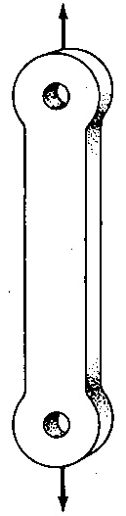
Stress...
Uniform stress is an approximation.
Valid only in simple loadings.
Away from ends.

Slide 12
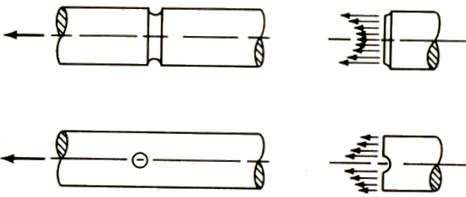
Non-Uniform Stresses

Slide 13
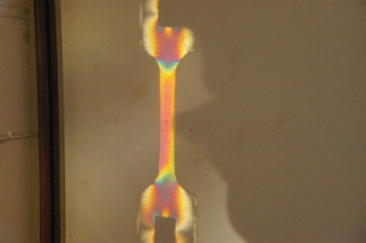
Non-Uniform Stresses...

Slide 14
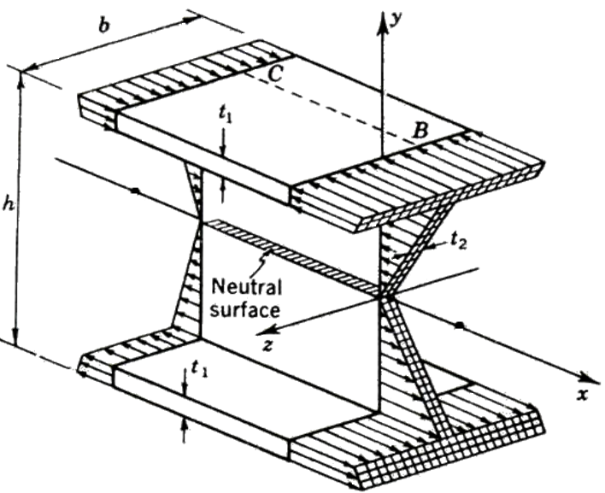
Non-Uniform Stresses...

Slide 15
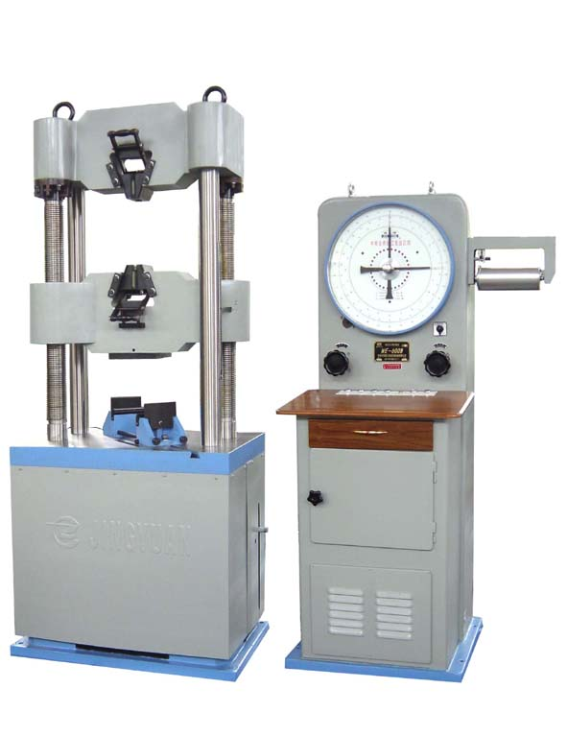
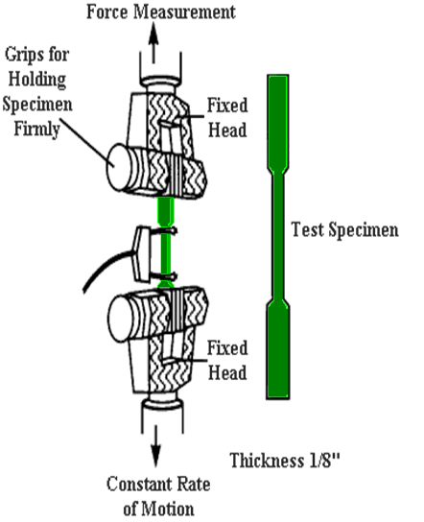
Stress-Strain Relationship
A material property.
Tensile Test Machine
UTM

Slide 16
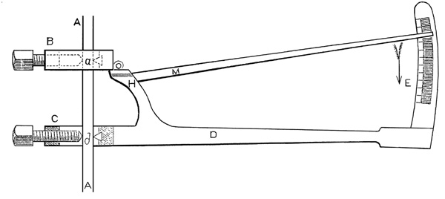
Extensometer

Slide 17
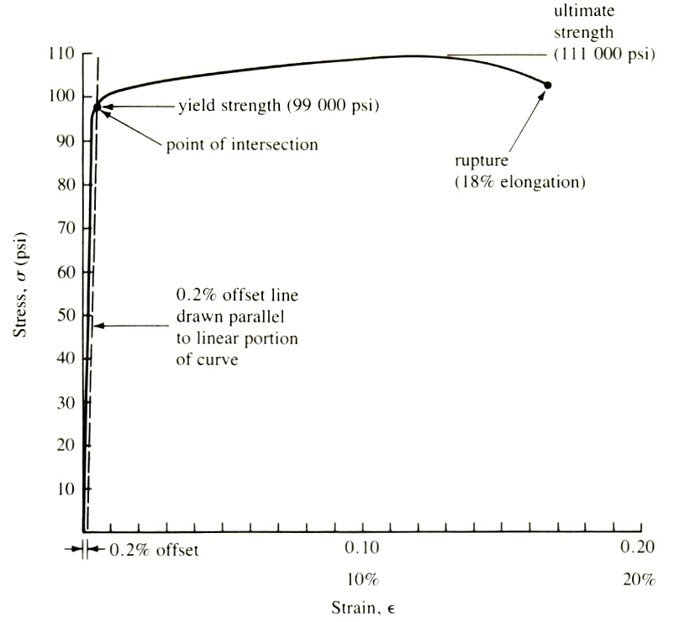
Stress-Strain Curve for 4140 Steel
Strain-hardening

Slide 18

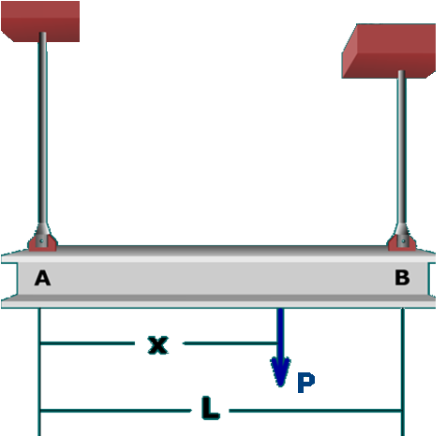





A Simple Example
2.6 m
1.3 m
F₂
F₁
150 kN
1 m

Slide 19

Another Simple (?) Problem
W = ρAxg
= T
σ = T/A = ρxg
72 m
ε = σ/E = ρxg/E
T
dδ = εdx = ρgxdx/E
dx
x
W(x)

Slide 20
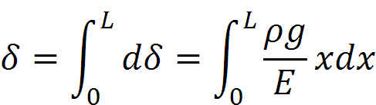
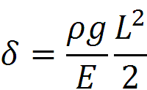
Another Simple (?) Problem...
dδ = εdx = ρgxdx/E
or
Using density of steel as 7.6X10³ kg/m³, and E as 200 GPa, we get ~ 1 mm
If Nylon wire, then density ~ 0.8X10³ kg/m³, and E as 400 MPa, we get ~ 52 mm

Slide 21
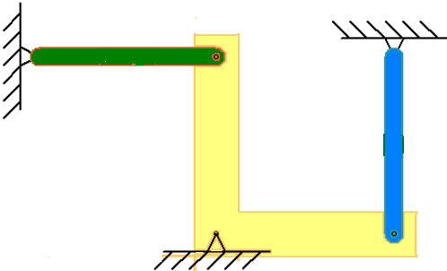
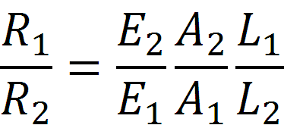
Statically Indeterminate Structure
K_{bar} = EA/L
R₁
Taking moments about the pivot point,
2R₁ + 2R₂ – P = 0
P
R₂
Geom. Comp.
δ₁ = δ₂
R₁/(E₁A₁/L₁) = R₂/(E₂A₂/L₂),

Slide 22
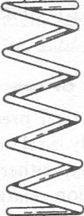

Statically Indeterminate Structure...
R₂ - F - R₁ = 0; R₁L – Fx = 0
Geom. Comp.
h + δ₁ = 2(h - δ₂)
F
h
h
R₁ = kδ₁
R₂ = kδ₂
L
x

Slide 23
Statically Indeterminate Structure...
P
P = R₁+ R₂
R₁ = (E₁A₁/L₁)δ₁
R₂
R₂ = (E₂A₂/L₂)δ₂
R₁
Geom. Comp.
δ₁ = δ₂

Slide 24
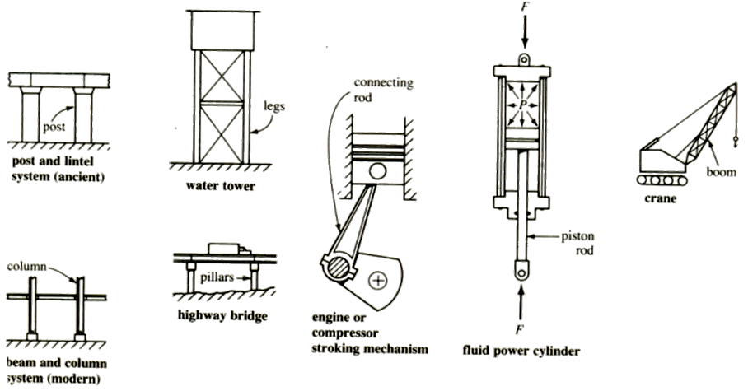
Structures Under Compression

Slide 25
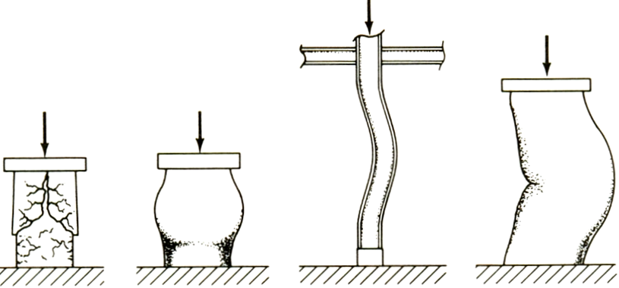
Failure Under Compression

Slide 26
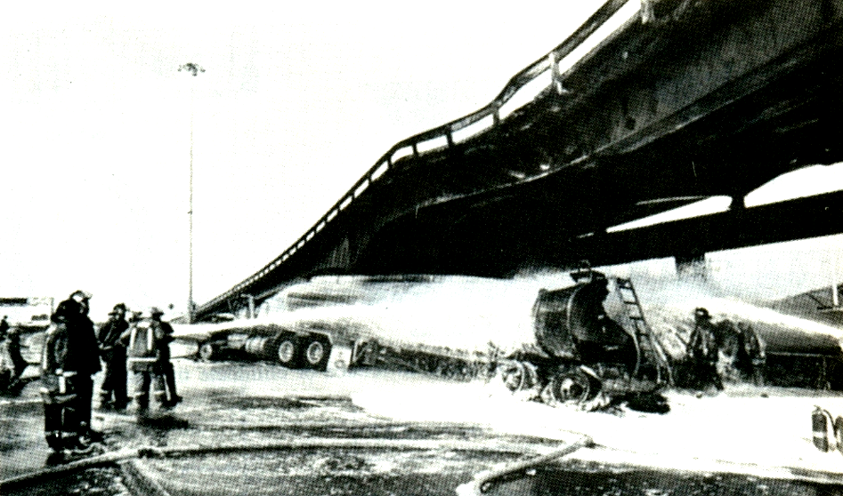
Buckling of a Bridge

Slide 27
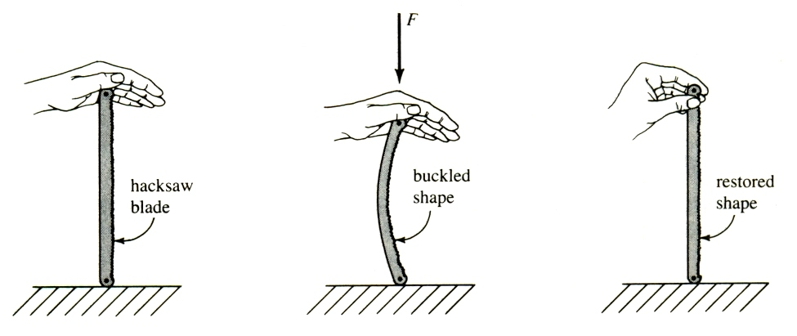
Elastic Buckling

Slide 28
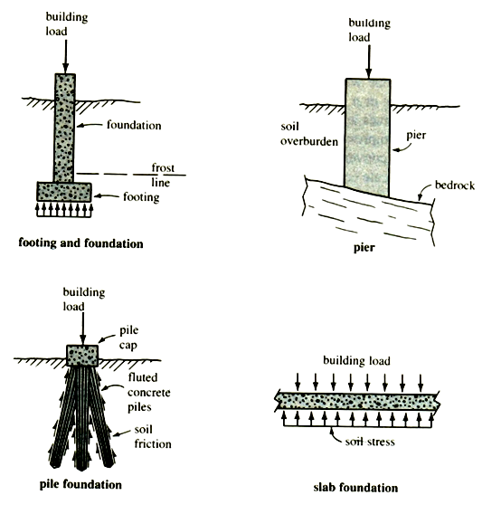
Foundations

Slide 29
Application
10⁵ N
Steel
Concrete
Soil

Slide 30

Shear Members
Shear Stress

Slide 31
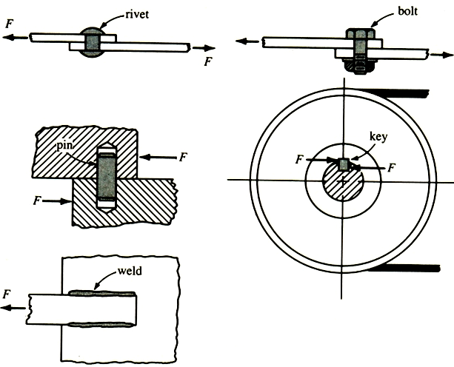
Structural Members with Shear loads

Slide 32

Rivets
Compression
Shear
Shear
Compression

Slide 33
Key
Compression
Shear

Slide 34
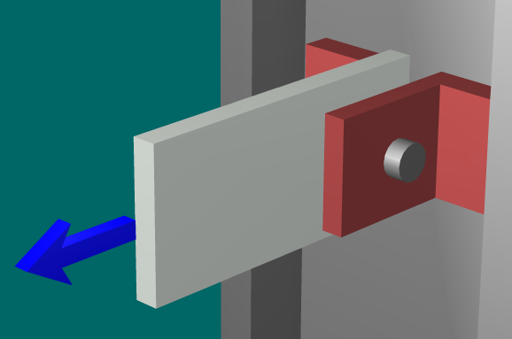
Shear Stresses in a Pin
Bearing (Compressive)
Shear

Slide 35
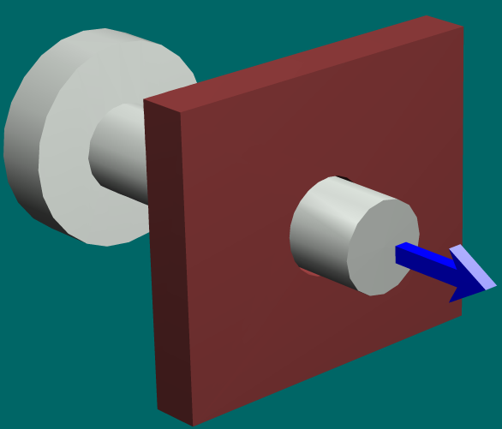
Rod & Collar
Bearing load
Shear load

Slide 36
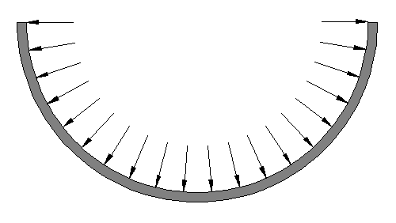
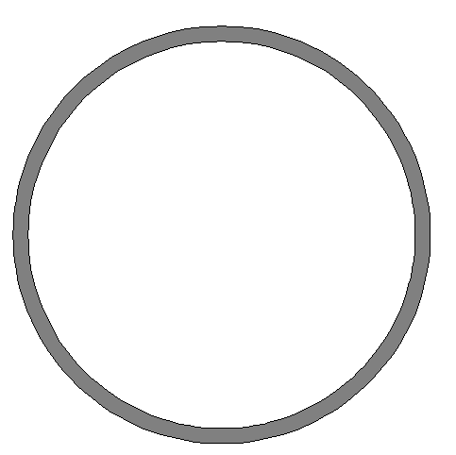
Thin Cylinder
F_{T}
F_{R}
F_{T}
F_{R}
p
We can show by symmetry arguments that:
(a) Both shear should be inwards or outwards
(b) Shear should be ZERO

Slide 37


Thin Cylinder
F_{T}
p
Equilirium:
F_{T} = 2σLt = p2rL
This gives:
Hoop stress

Slide 38



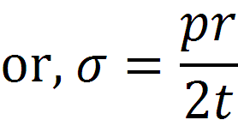
Thin Cylinder
p
Axial stress

Slide 39

Thin spherical shell
p

Slide 40
Stress-Strain Relationship
σ_{xx}
ε_{xx} = σ_{xx}/E
σ_{xx}

Slide 41
Poisson Ratio
σ_{xx}
ε_{yy} = - νε_{xx}
ν is Poisson ratio
σ_{xx}

Slide 42
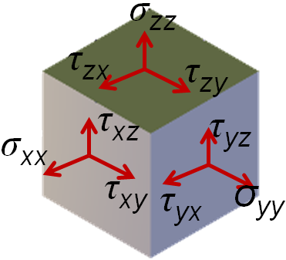
Stress-Strain Relationship
Let us consider ε_{xx}. σ_{xx} produces an ε_{xx} = σ_{xx} /E.
σ_{yy} produces an ε_{yy} = σ_{yy} /E, which through Poisson ratio gives ε_{xx} = -νε_{yy} = - νσ_{yy}/E.
Similarly for σ_{zz} .

Slide 43
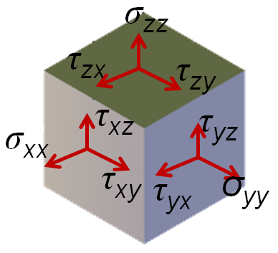
Generalized Hookes Law
Shear stresses do not cause any normal strain
ε_{xx} = σ_{xx}/E – νσ_{yy}/E - νσ_{zz}/E
= [σ_{xx} – ν(σ_{yy} + σ_{zz})]/E

Slide 44
Generalized Hookes Law...
γ_{xy} = τ_{xy}/G,
where G is shear modulous.
It can be shown that γ_{xy} does not depend on other components of stress.

Slide 45
Generalized Hookes Law...
γ_{xy} = τ_{xy}/G,
where G is shear modulous.
Material | E GPa | G GPa | ν
Aluminium | 70 | 25 | 0.33 (1/3)
Steel | 200 | 80 | 0.27 (1/4)
Glass | 50-80 | 26-32 | 0.21-0.27
Soft Rubber | 0.0008-0.004 | 0.003- 0.001 | 0.50

Slide 46
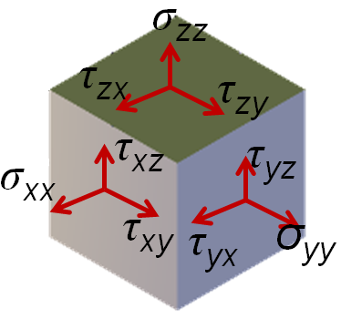
Generalized Hookes Law...
ε_{xx} = σ_{xx}/E – νσ_{yy}/E - νσ_{zz}/E
= [σ_{xx} – ν(σ_{yy} + σ_{zz})]/E
γ_{xy} = τ_{xy}/G, where G is shear modulus

Slide 47



Thermal Strains
There is no thermal shear strain
Material | α ×10⁻⁶/ºC
Steel | ~10
Aluminium | ~20

Slide 48
Generalized Hookes Law
ε_{xx} = [σ_{xx} – ν(σ_{yy} + σ_{zz})]/E + αΔT
ε_{yy} = [σ_{yy} – ν(σ_{zz} + σ_{xx})]/E + αΔT
γ_{xy} = τ_{xy}/G

Slide 49
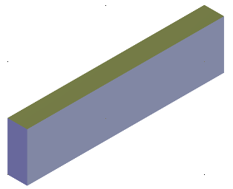
An Example
σ_{yy}
Steel: ε_{x} = 0.6E-4; ε_{y} = 0.3E-4
σ_{xx}
Find σ_{xx} and σ_{yy}.
E = 200 GPa, ν = 0.3

Slide 50
Another Example
Aluminium rod, rigid supports.
Temperature raised by ΔT.
What are the stresses?
ε_{xx} = 0 = [σ_{xx}/E + αΔT]

